Slide 1

IMAGE DEBLURRING USING DEEP LEARNING
Submitted by :
S . Kavya (21UP1A6656)
Guide:
Name: Mrs. J. Narmada
Designation: Assistant Professor
Department: AIML

Slide 2
Contents
Abstract
Introduction
Problem Statement
Literature Survey
Existing System
Limitations of Existing System
Proposed System
Module Split-up
System Requirements Specifications
Model Architecture
Result
Conclusion

Slide 3
Abstract
This project focuses on Image Deblurring Using Deep Learning, a critical area in image processing aimed at restoring sharp and clear images from blurred ones. The objective is to develop a model utilizing Convolutional Neural Networks (CNNs) and autoencoders to enhance image quality. The hybrid architecture extracts features from blurred images and reconstructs deblurred images, demonstrating effectiveness across domains like medical diagnostics, surveillance, and photography. This solution addresses limitations of traditional methods, including sensitivity to assumptions and lack of real-time processing, and leverages deep learning for robust performance.

Slide 4
Introduction
Image de-blurring is the process of removing or reducing blur from a photograph or image to make it sharper and clearer.
Image de-blurring is a challenging task that aims to restore a sharp and clear image from a blurred one.
The goal of this project is to develop a model that can effectively remove blur from an image and improve its quality using Deep learning techniques.
Its significance extends to various applications like medical diagnostics, surveillance etc. where high-quality images are used for decision-making and analysis.
Notes:
Image source: https://gospelpolaris.tistory.com/24

Slide 5
Problem Statement
Image Deblurring Using Deep Learning. Blurred images can also make it difficult to perform tasks such as object recognition or identification, as the details required for such tasks may be lost.

Slide 6
Literature Survey
S.no | Title | Details | Methodologies/ Achievements | Limitations/ Drawbacks
1. | Deep Image Deblurring: A Survey | Kaihao Zhang, Wenqi Ren, Wenhan Luo https://link.springer.com/article/10.1007/s11263-022-01633-5 | Provides a comprehensive review of deep-learning-based image deblurring approaches. | Primarily focuses on CNN-based methods; may not cover other machine learning approaches in detail.
2. | An Image Deblurring Method Using Improved U-Net Model | Zuozheng Lian, Haizhen Wang https://onlinelibrary.wiley.com/doi/10.1155/2022/6394788 | Proposes an improved U-Net model incorporating depth-wise separable convolution and wavelet transform to enhance deblurring performance | The method may have limitations in handling certain types of blur or in generalizing to diverse datasets
3. | An Efficient Image Deblurring Network with a Hybrid Architecture | Mingju Chen, Sihang Yi https://www.mdpi.com/1424-8220/23/16/7260 | Develops a hybrid architecture combining CNN and transformer modules for image deblurring. | The integration of transformer modules may lead to higher computational demands.

Slide 7
Existing System
Wiener Filter Based Methods
This classical technique aims to restore a clear image from a degraded or blurry version by minimizing the mean square error between the estimated and observed images.
The Wiener filter considers the observed image, point spread function (PSF), and the power spectrum of the noise.
Richardson-Lucy Deconvolution
The algorithm iteratively refines the estimate of the true image based on the observed blurry image and the estimated PSF.
The update rule involves convolution with the inverse of the estimated PSF and is repeated through multiple iterations.

Slide 8
Limitations of Existing System
Sensitivity to assumptions
Limited effectiveness for complex blurs
Computationally intensive
Lack of real-time processing

Slide 9
Proposed System
The proposed solution leverages the combination of Convolutional Neural Networks (CNNs) and autoencoders that is CNN based autoencoder architecture.
The system involves training a deep learning model by leveraging the power of CNNs for feature extraction and Autoencoders for image reconstruction.
In the hybrid model the CNNs act as the encoder, extracting hierarchical features from the blurred input images.
The autoencoder serves as the decoder, reconstructing sharp, deblurred images.
This combination allows our model to effectively learn and represent the complex relationships between blurred and sharp image pairs

Slide 10
Module Split-up
Dataset Preparation
Dataset Loading and Preprocessing
Model Architecture
Model Training
Evaluation and visualization
Model Saving

Slide 11
HARDWARE REQUIREMENTS
System Specifications
SOFTWARE REQUIREMENTS
Operating System: Windows Environment
Platforms: Visual studio code (1.81.1)
Libraries: OpenCV, Matplotlib, Scikit-learn, transformers
Framework: PyTorch
Language: Python 3.11
Processor: Intel i5
Hard disk: 256 GB or above
RAM: 512Mb or more
GPU:NVIDIA
Notes:
Image source: http://www.projectsof8051.com/android-mobile-controlled-door-security-locking-system/

Slide 12
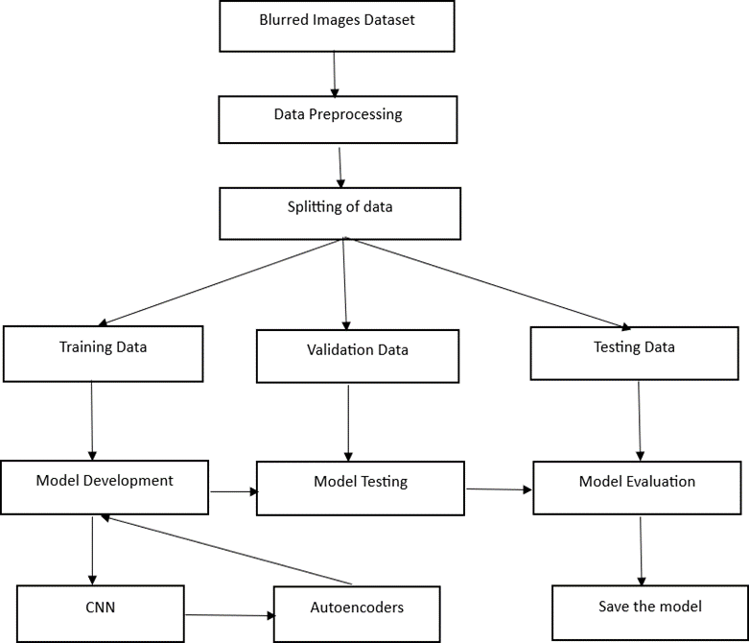
Model Architecture

Slide 13
Algorithms used
Convolutional Neural Networks (CNNs): Used for feature extraction from blurred images.
Autoencoders: Deployed for image reconstruction, where CNNs act as the encoder and reconstruct sharper images through the decoder.
MSE Loss Function: Applied during model training to measure the pixel-wise difference between the reconstructed sharp image and the original sharp image.

Slide 14

Result

Slide 15
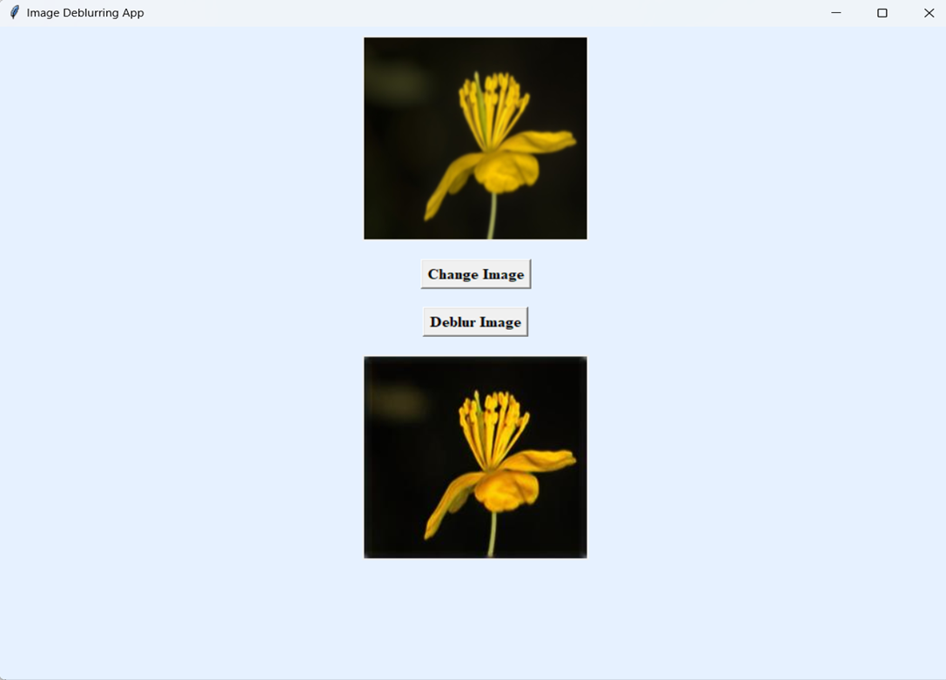
Result

Slide 16
Conclusion
CNN-based autoencoder model has demonstrated its efficacy in significantly reducing image blurring, yielding sharper and clearer images. The image deblurring project effectively demonstrated the capability of various algorithms to significantly enhance the quality of blurred images.This project contributes to advancing image processing techniques and emphasizes the need for ongoing research to develop more sophisticated and efficient deblurring algorithms for practical implementationThe Image Deblurring findings highlight the potential applications of image deblurring in fields like medical imaging, surveillance, and photography.

Slide 17
References
Deep Image Deblurring: A Survey
https://link.springer.com/article/10.1007/s11263-022-01633-5
2. An Image Deblurring Method Using Improved U-Net Model
https://onlinelibrary.wiley.com/doi/10.1155/2022/6394788
3. An Efficient Image Deblurring Network with a Hybrid Architecture
https://www.mdpi.com/1424-8220/23/16/7260

Slide 18
THANK YOU

